Slide 1

Communication between the Ventspils Tourism Information Centre and Tourists.

Slide 2
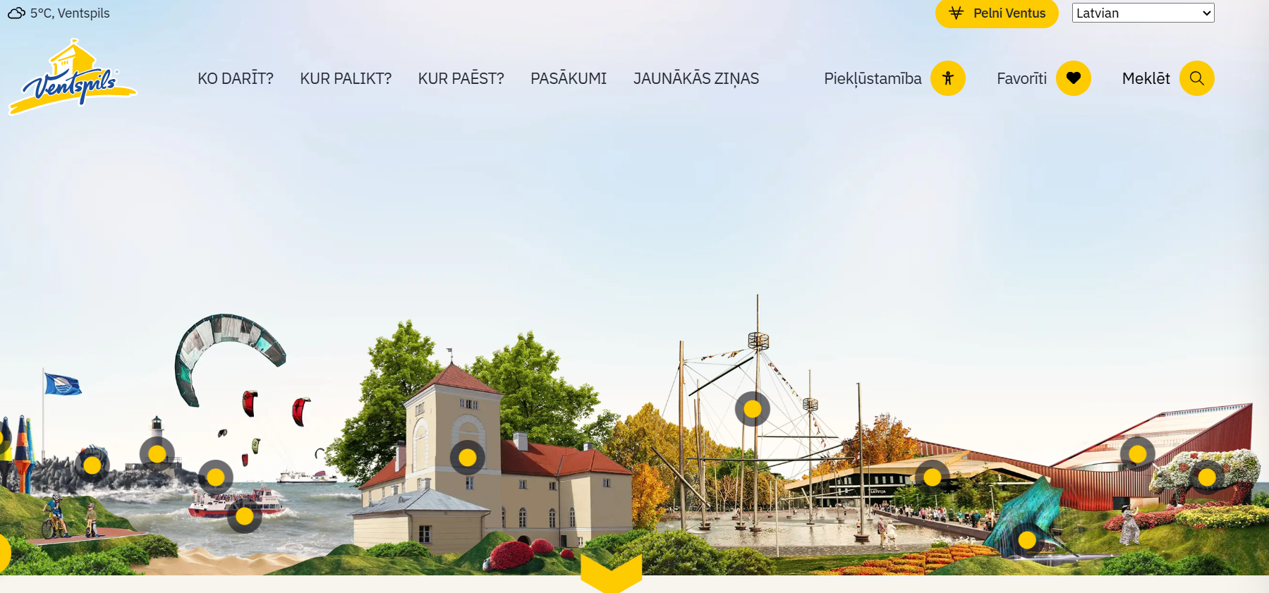
Visit Ventspils website
www.visitventspils.com

Slide 3
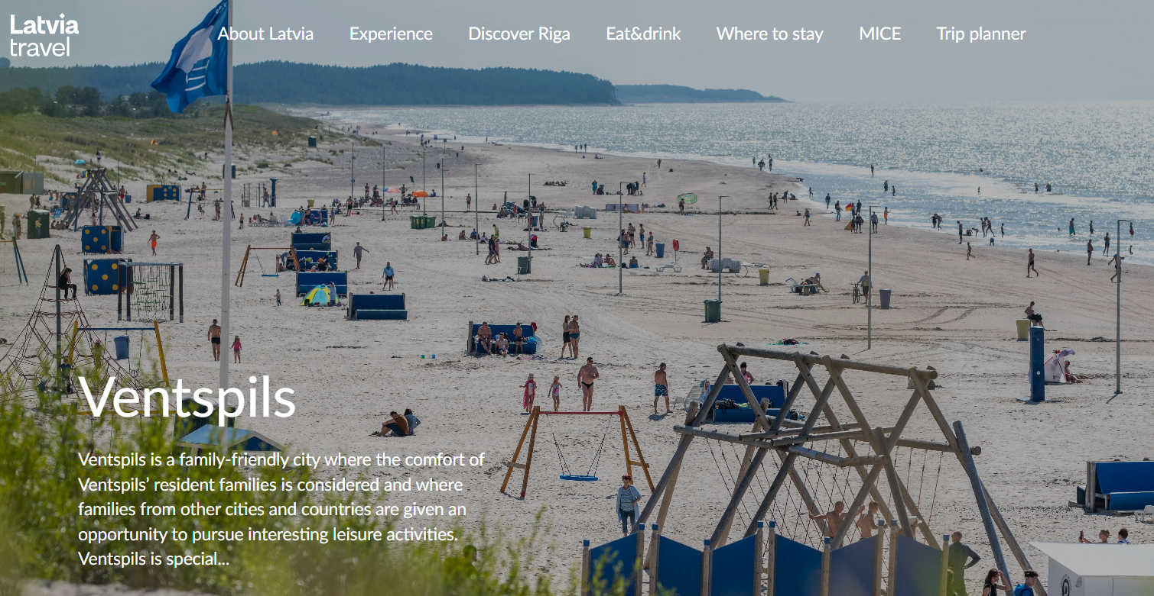
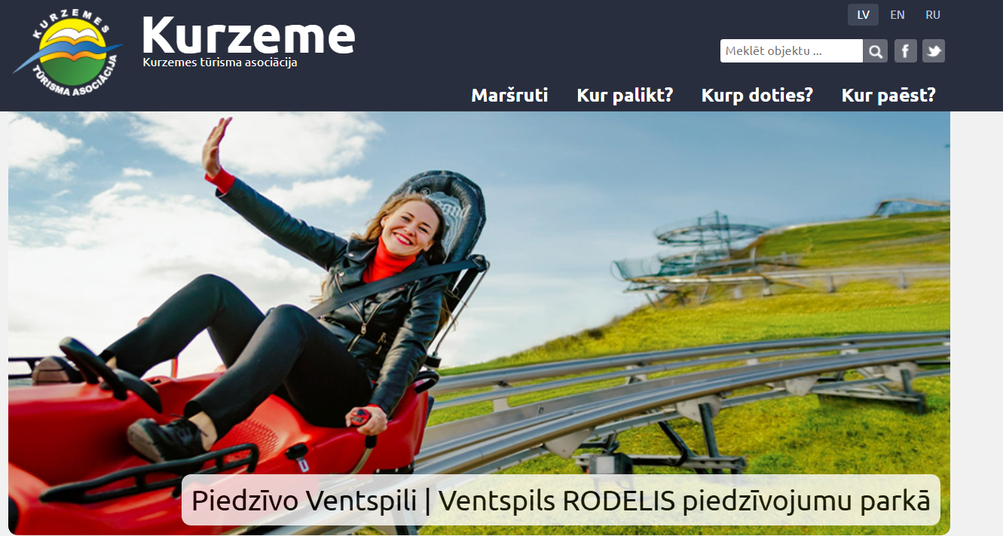
Alternative sources of information about Ventspils
Latvia and Kurland official websites, social media
www.visitventspils.com

Slide 4
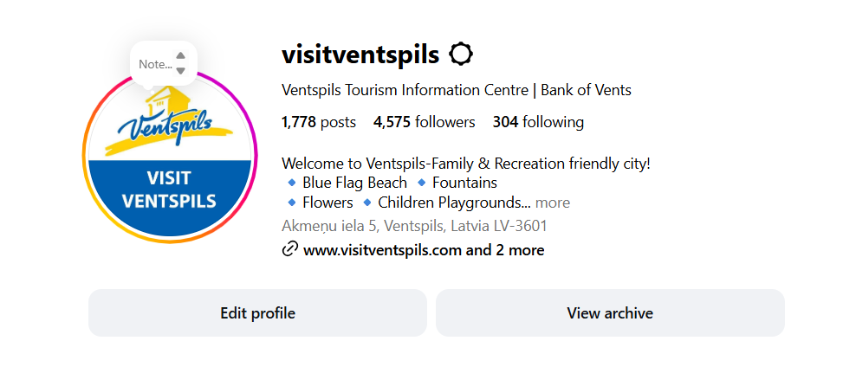
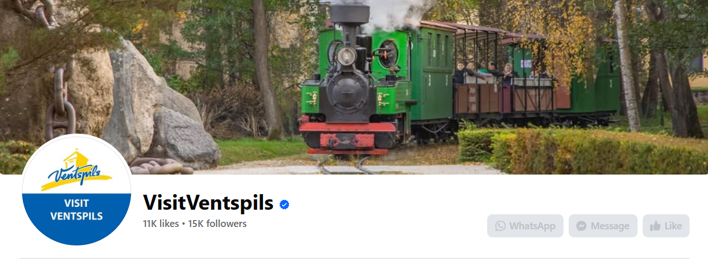
Social media
Facebook
Instagram
www.visitventspils.com

Slide 5
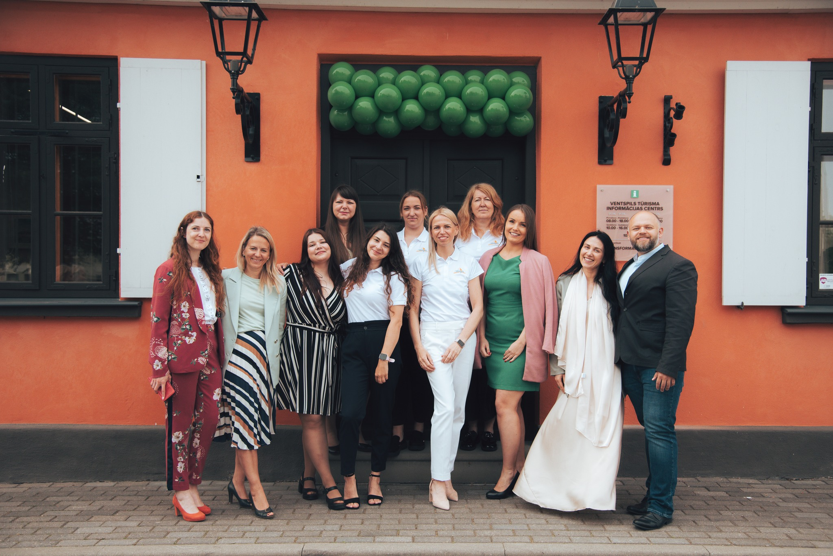
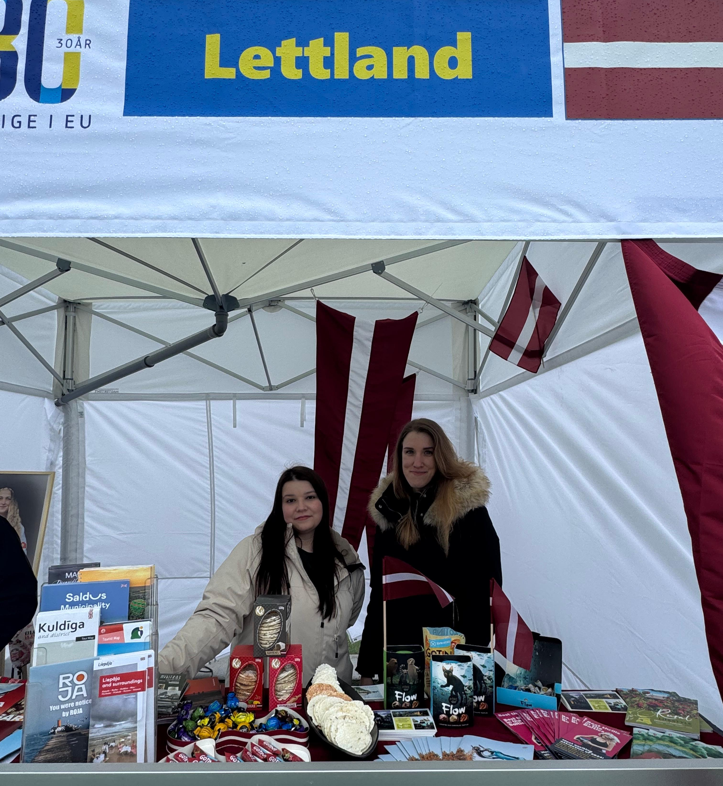
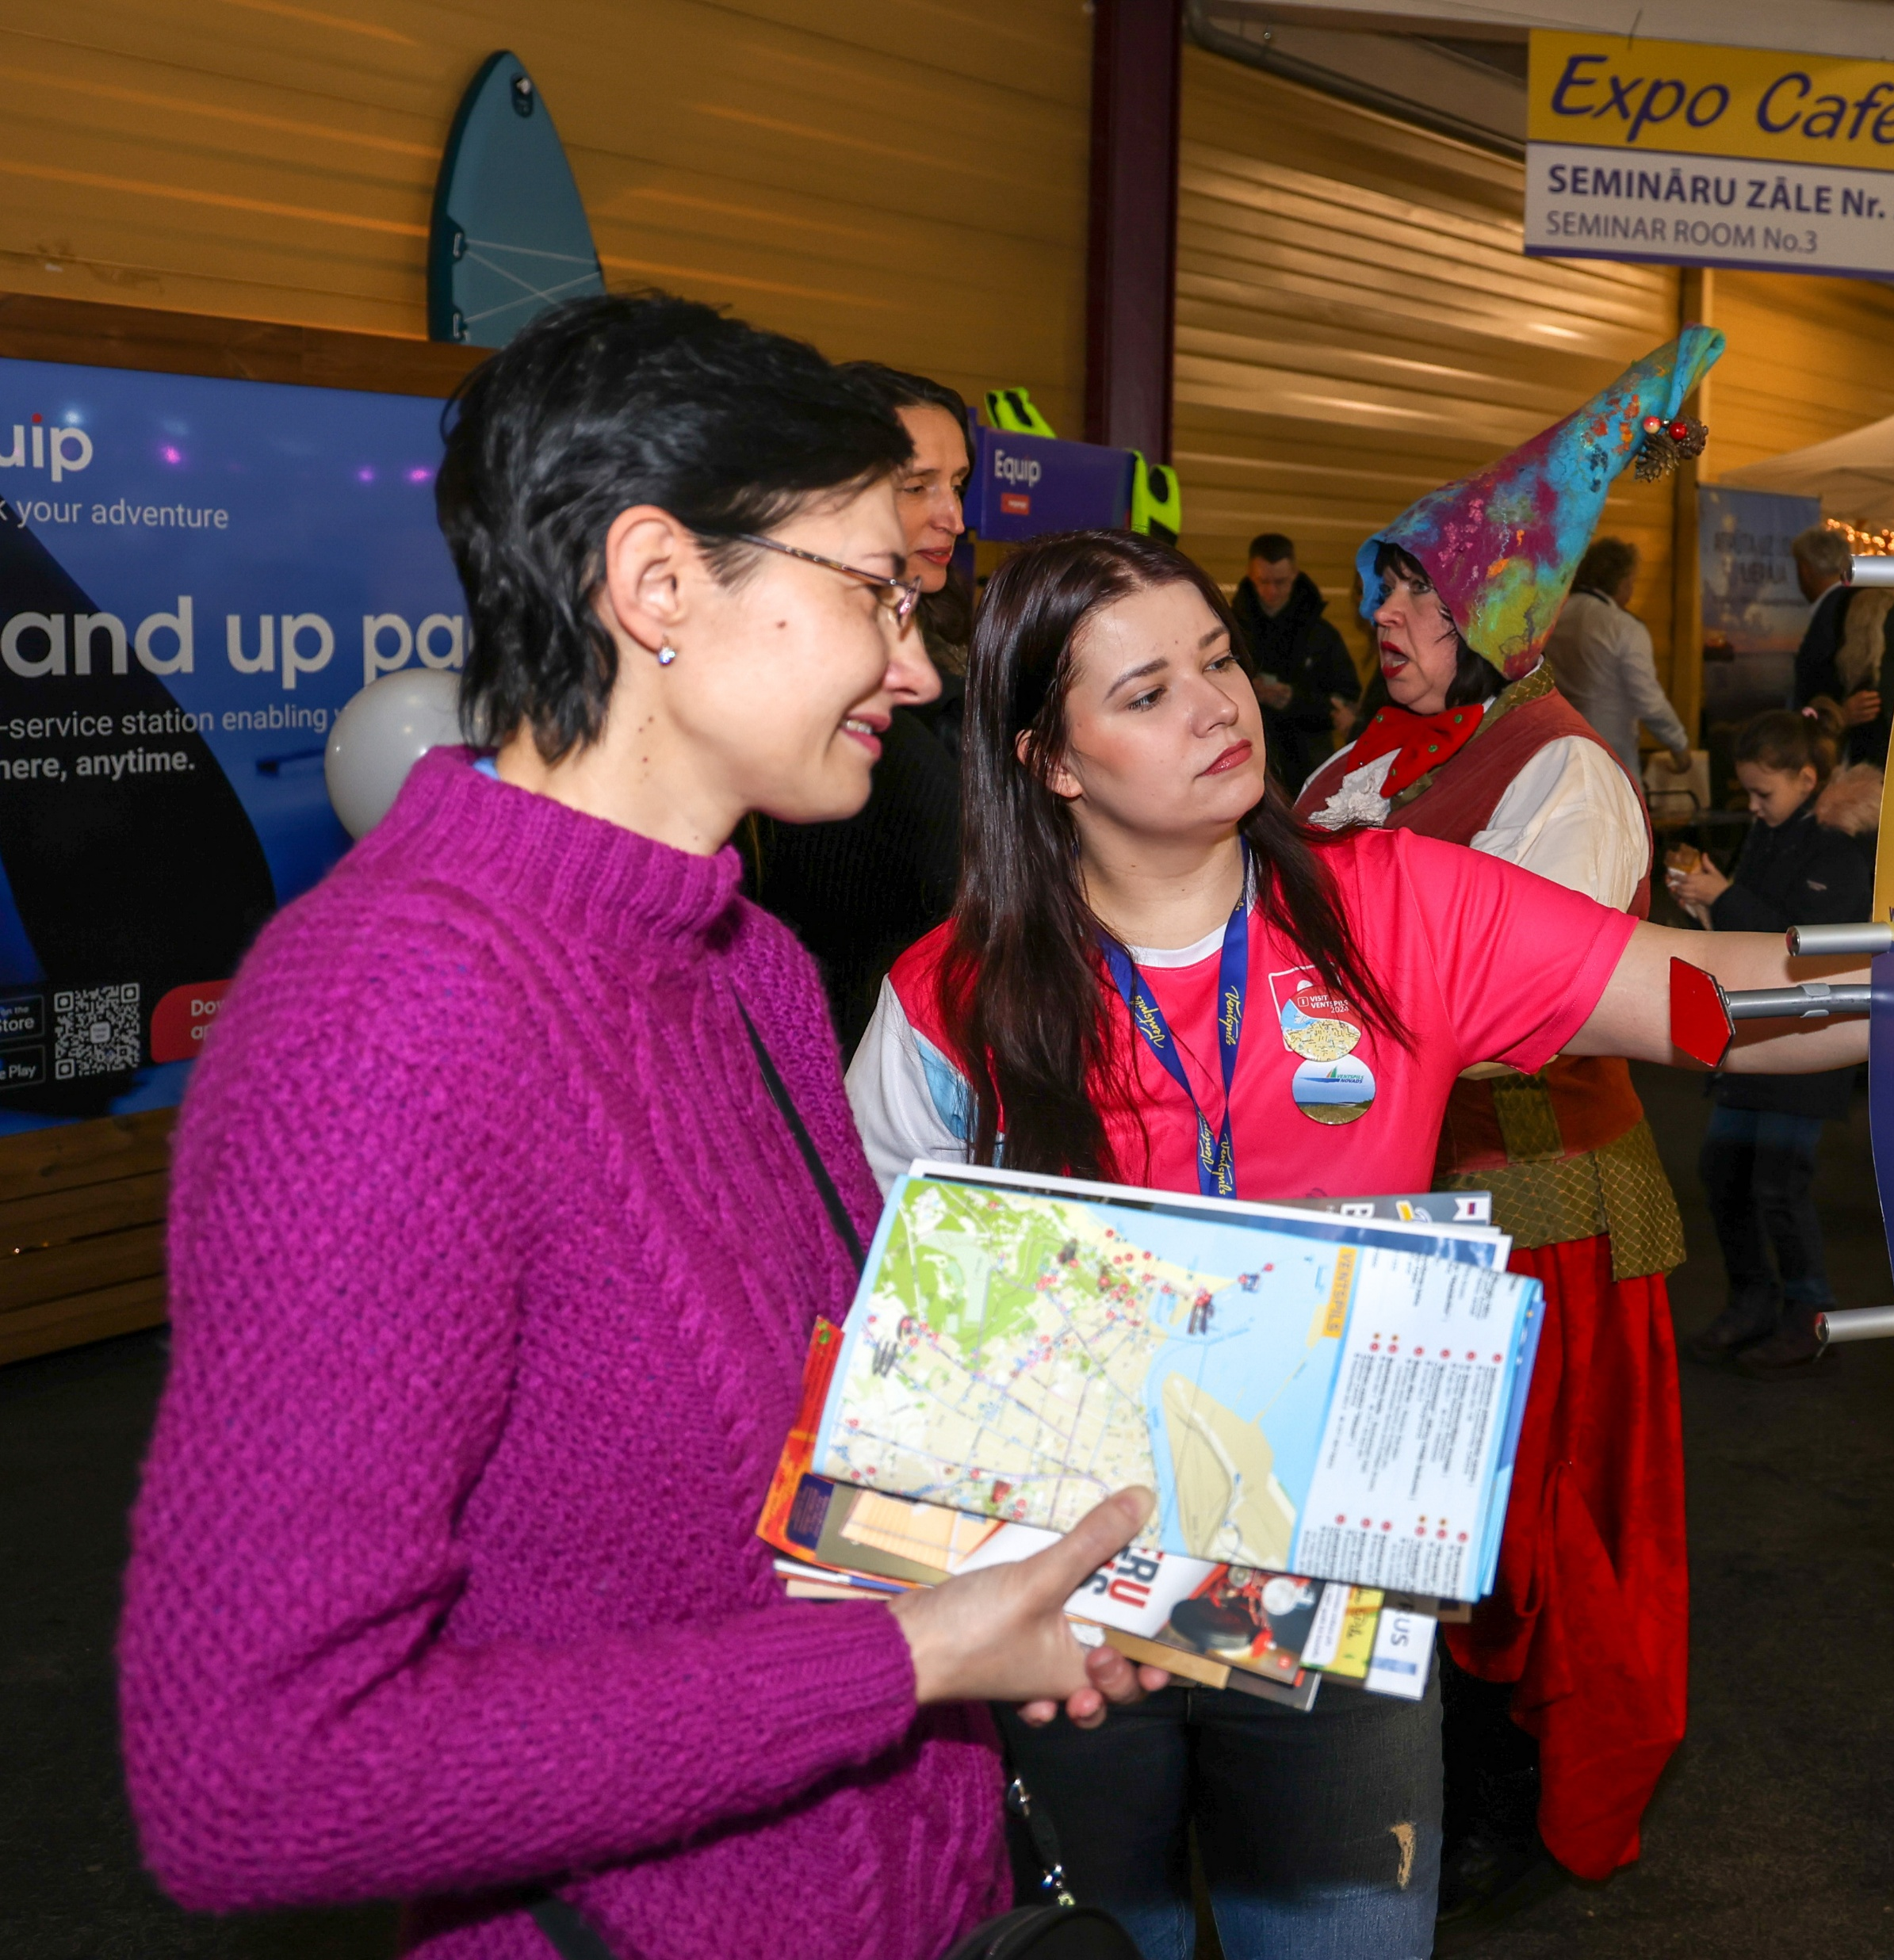
Live communication
At the Tourism Information Centre
Tourism fairs
www.visitventspils.com

Slide 6
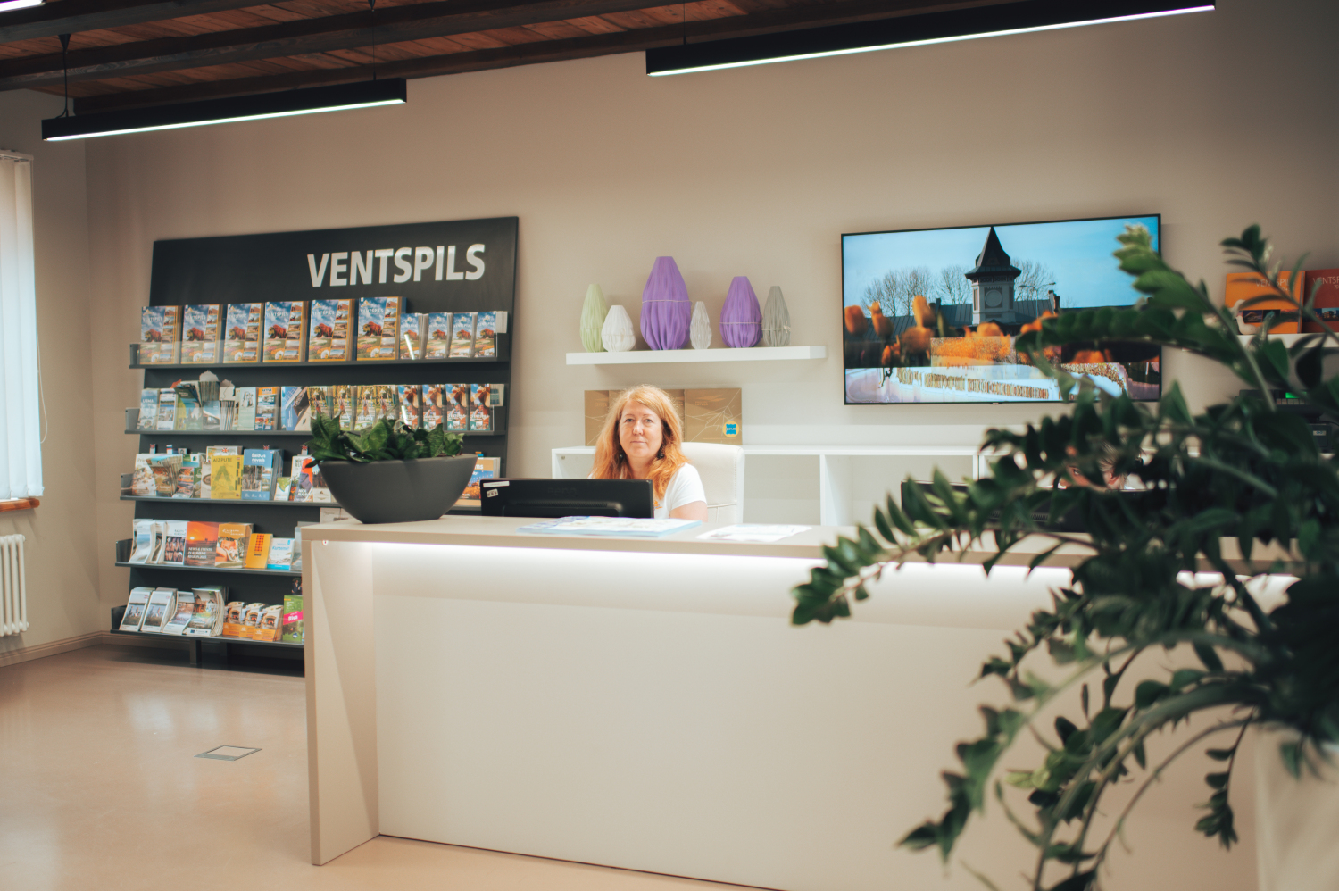
By email or by phone
E-mail; phone calls
www.visitventspils.com

Slide 7
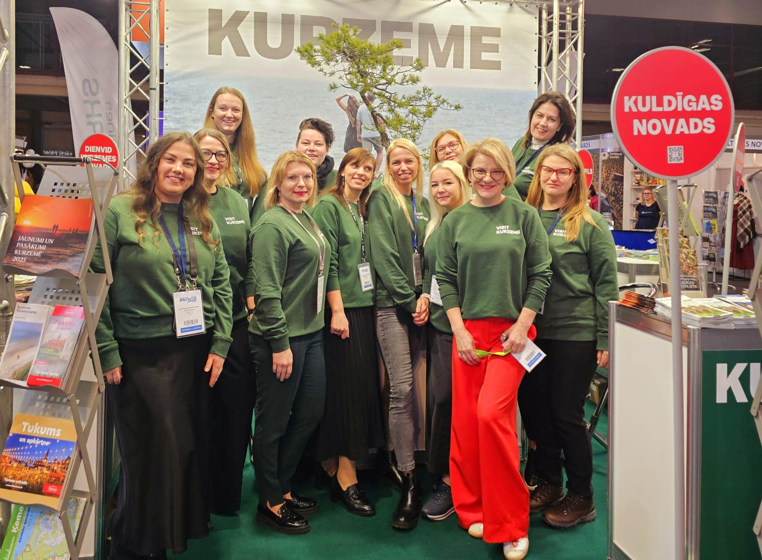
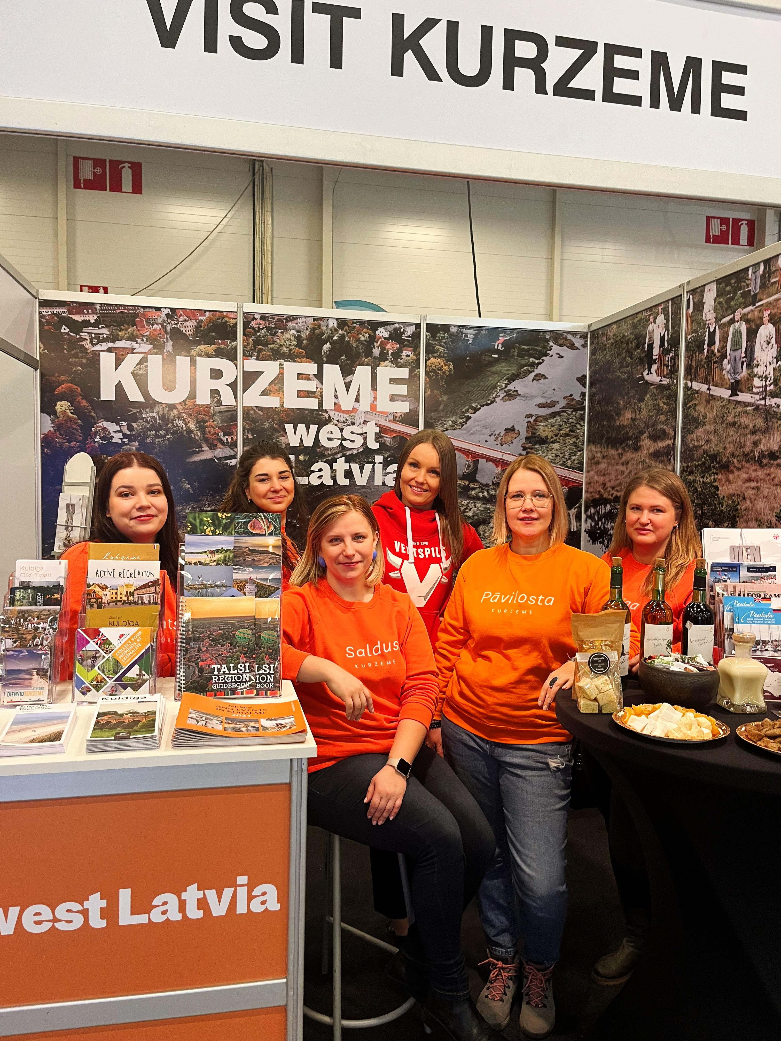
Kurzeme Tourism Association
www.visitventspils.com

Slide 8
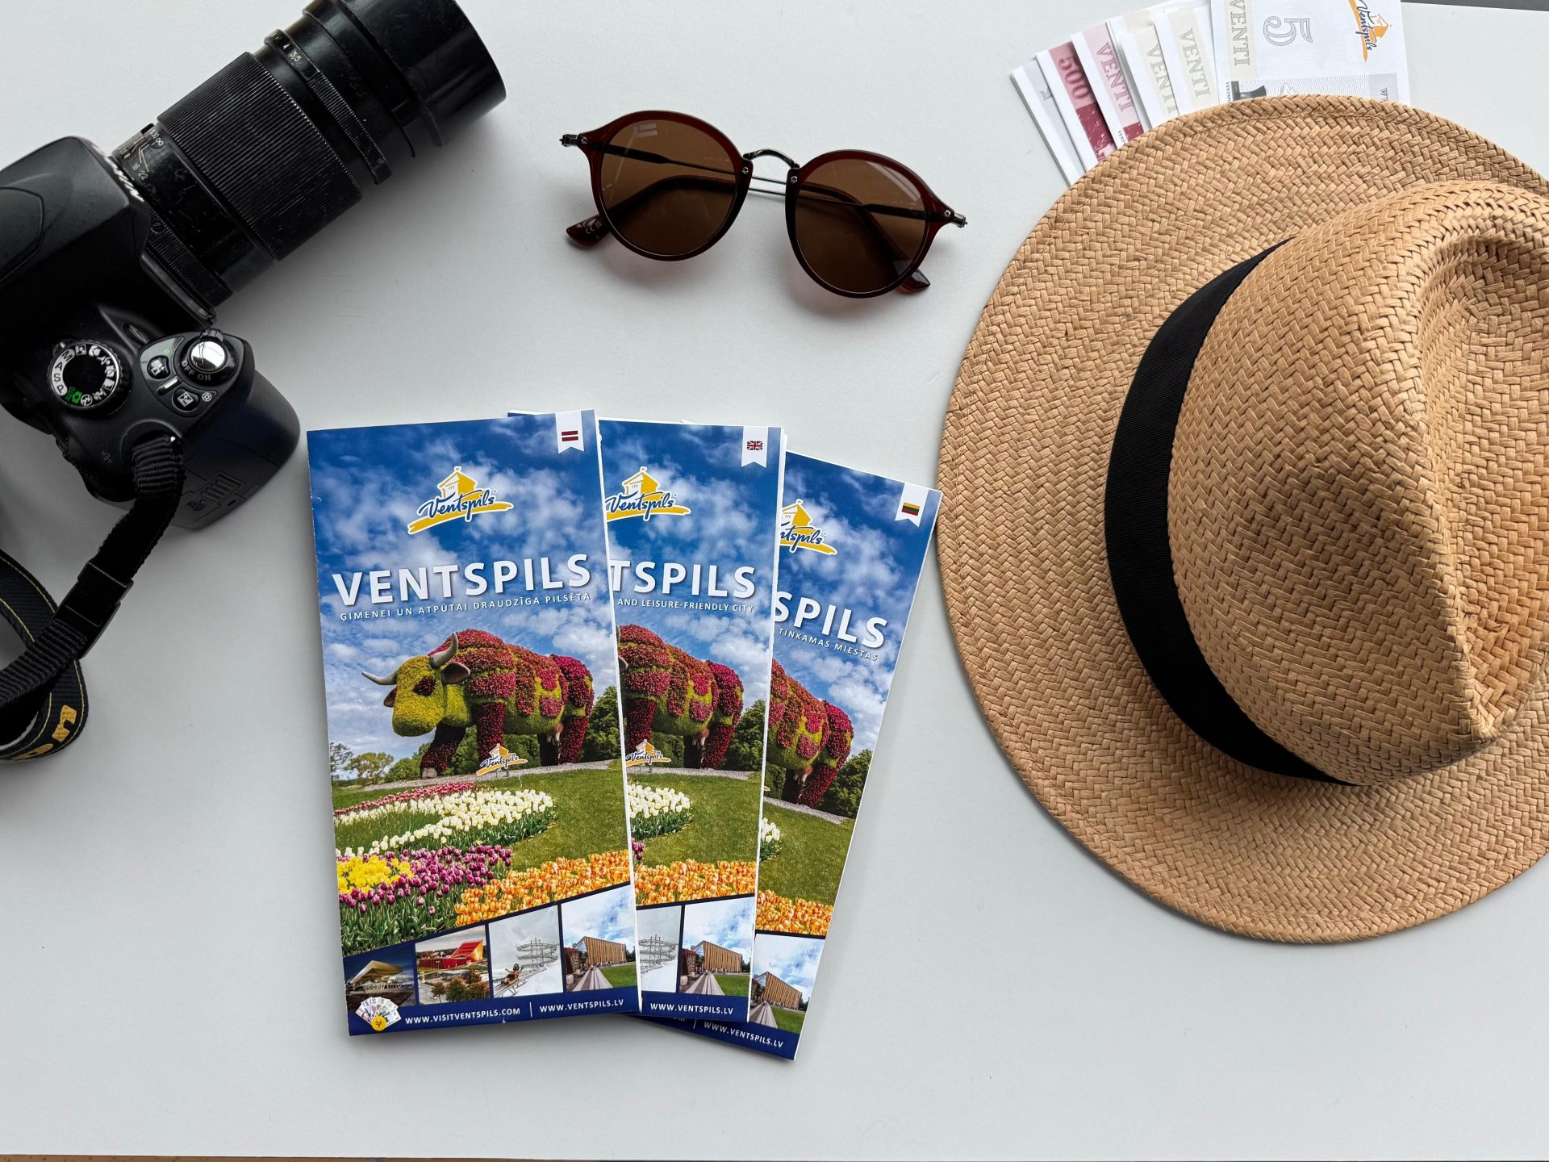
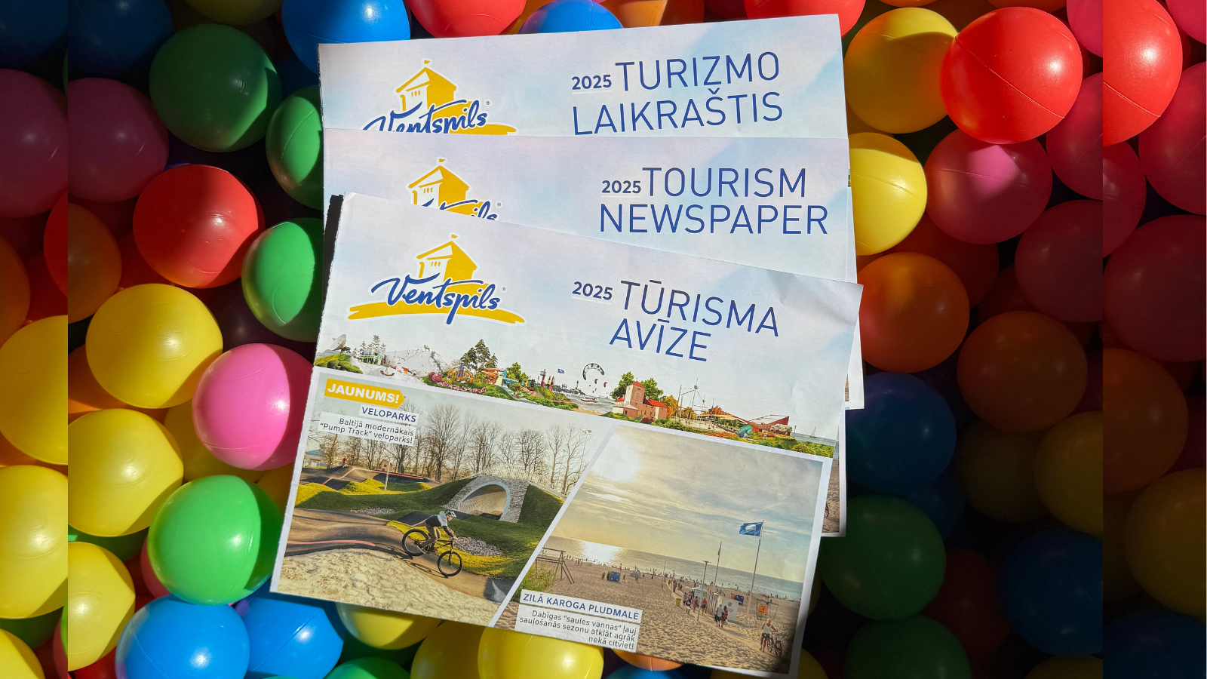
Tourism materials
www.visitventspils.com

Slide 9
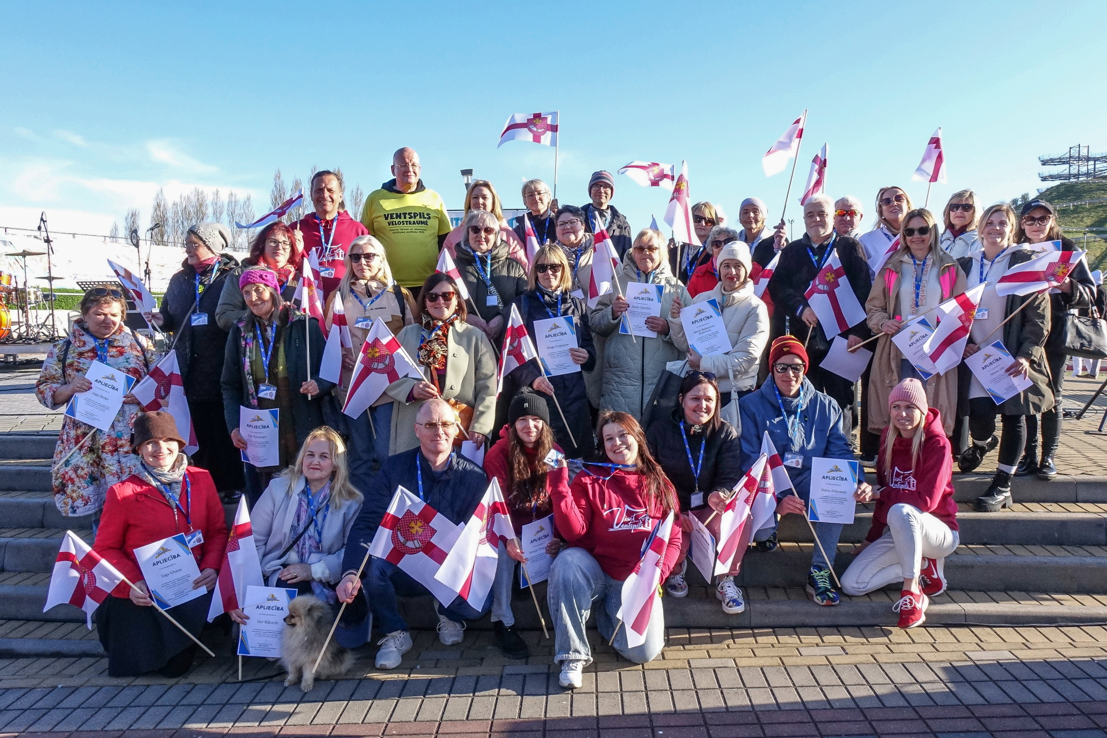
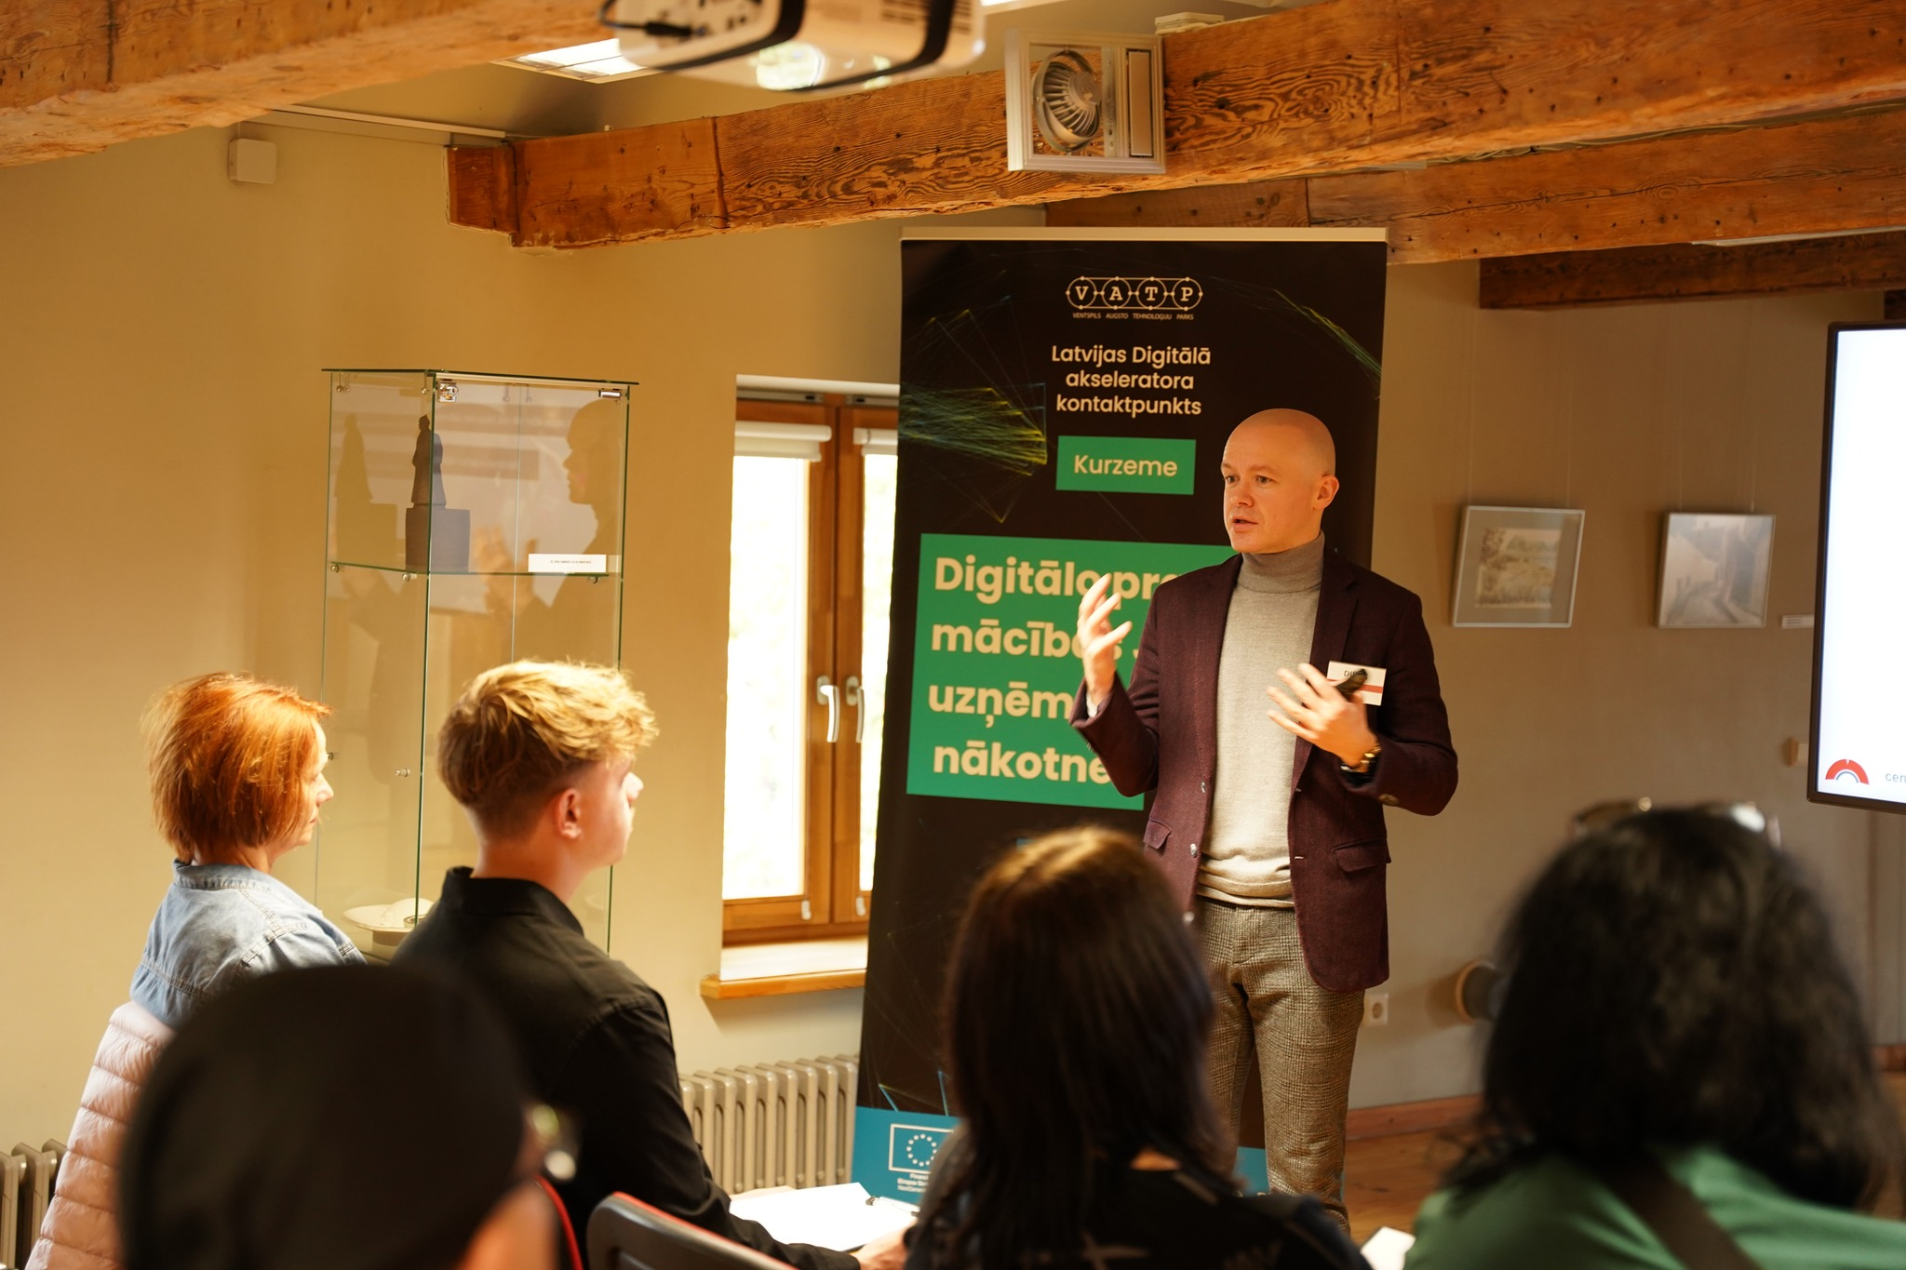
Organized trainings
www.visitventspils.com

Slide 10
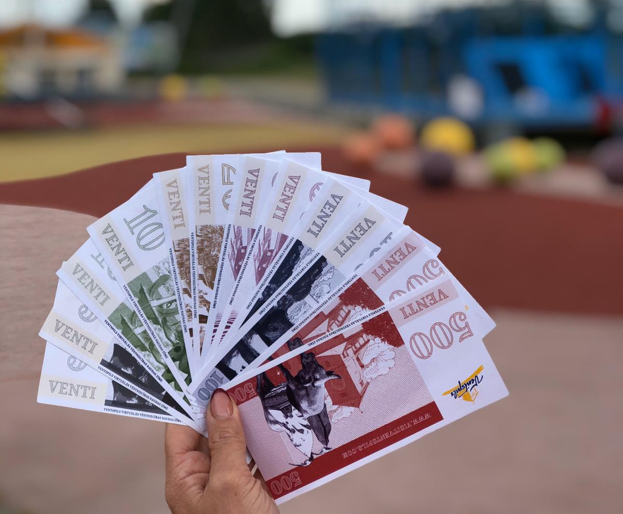
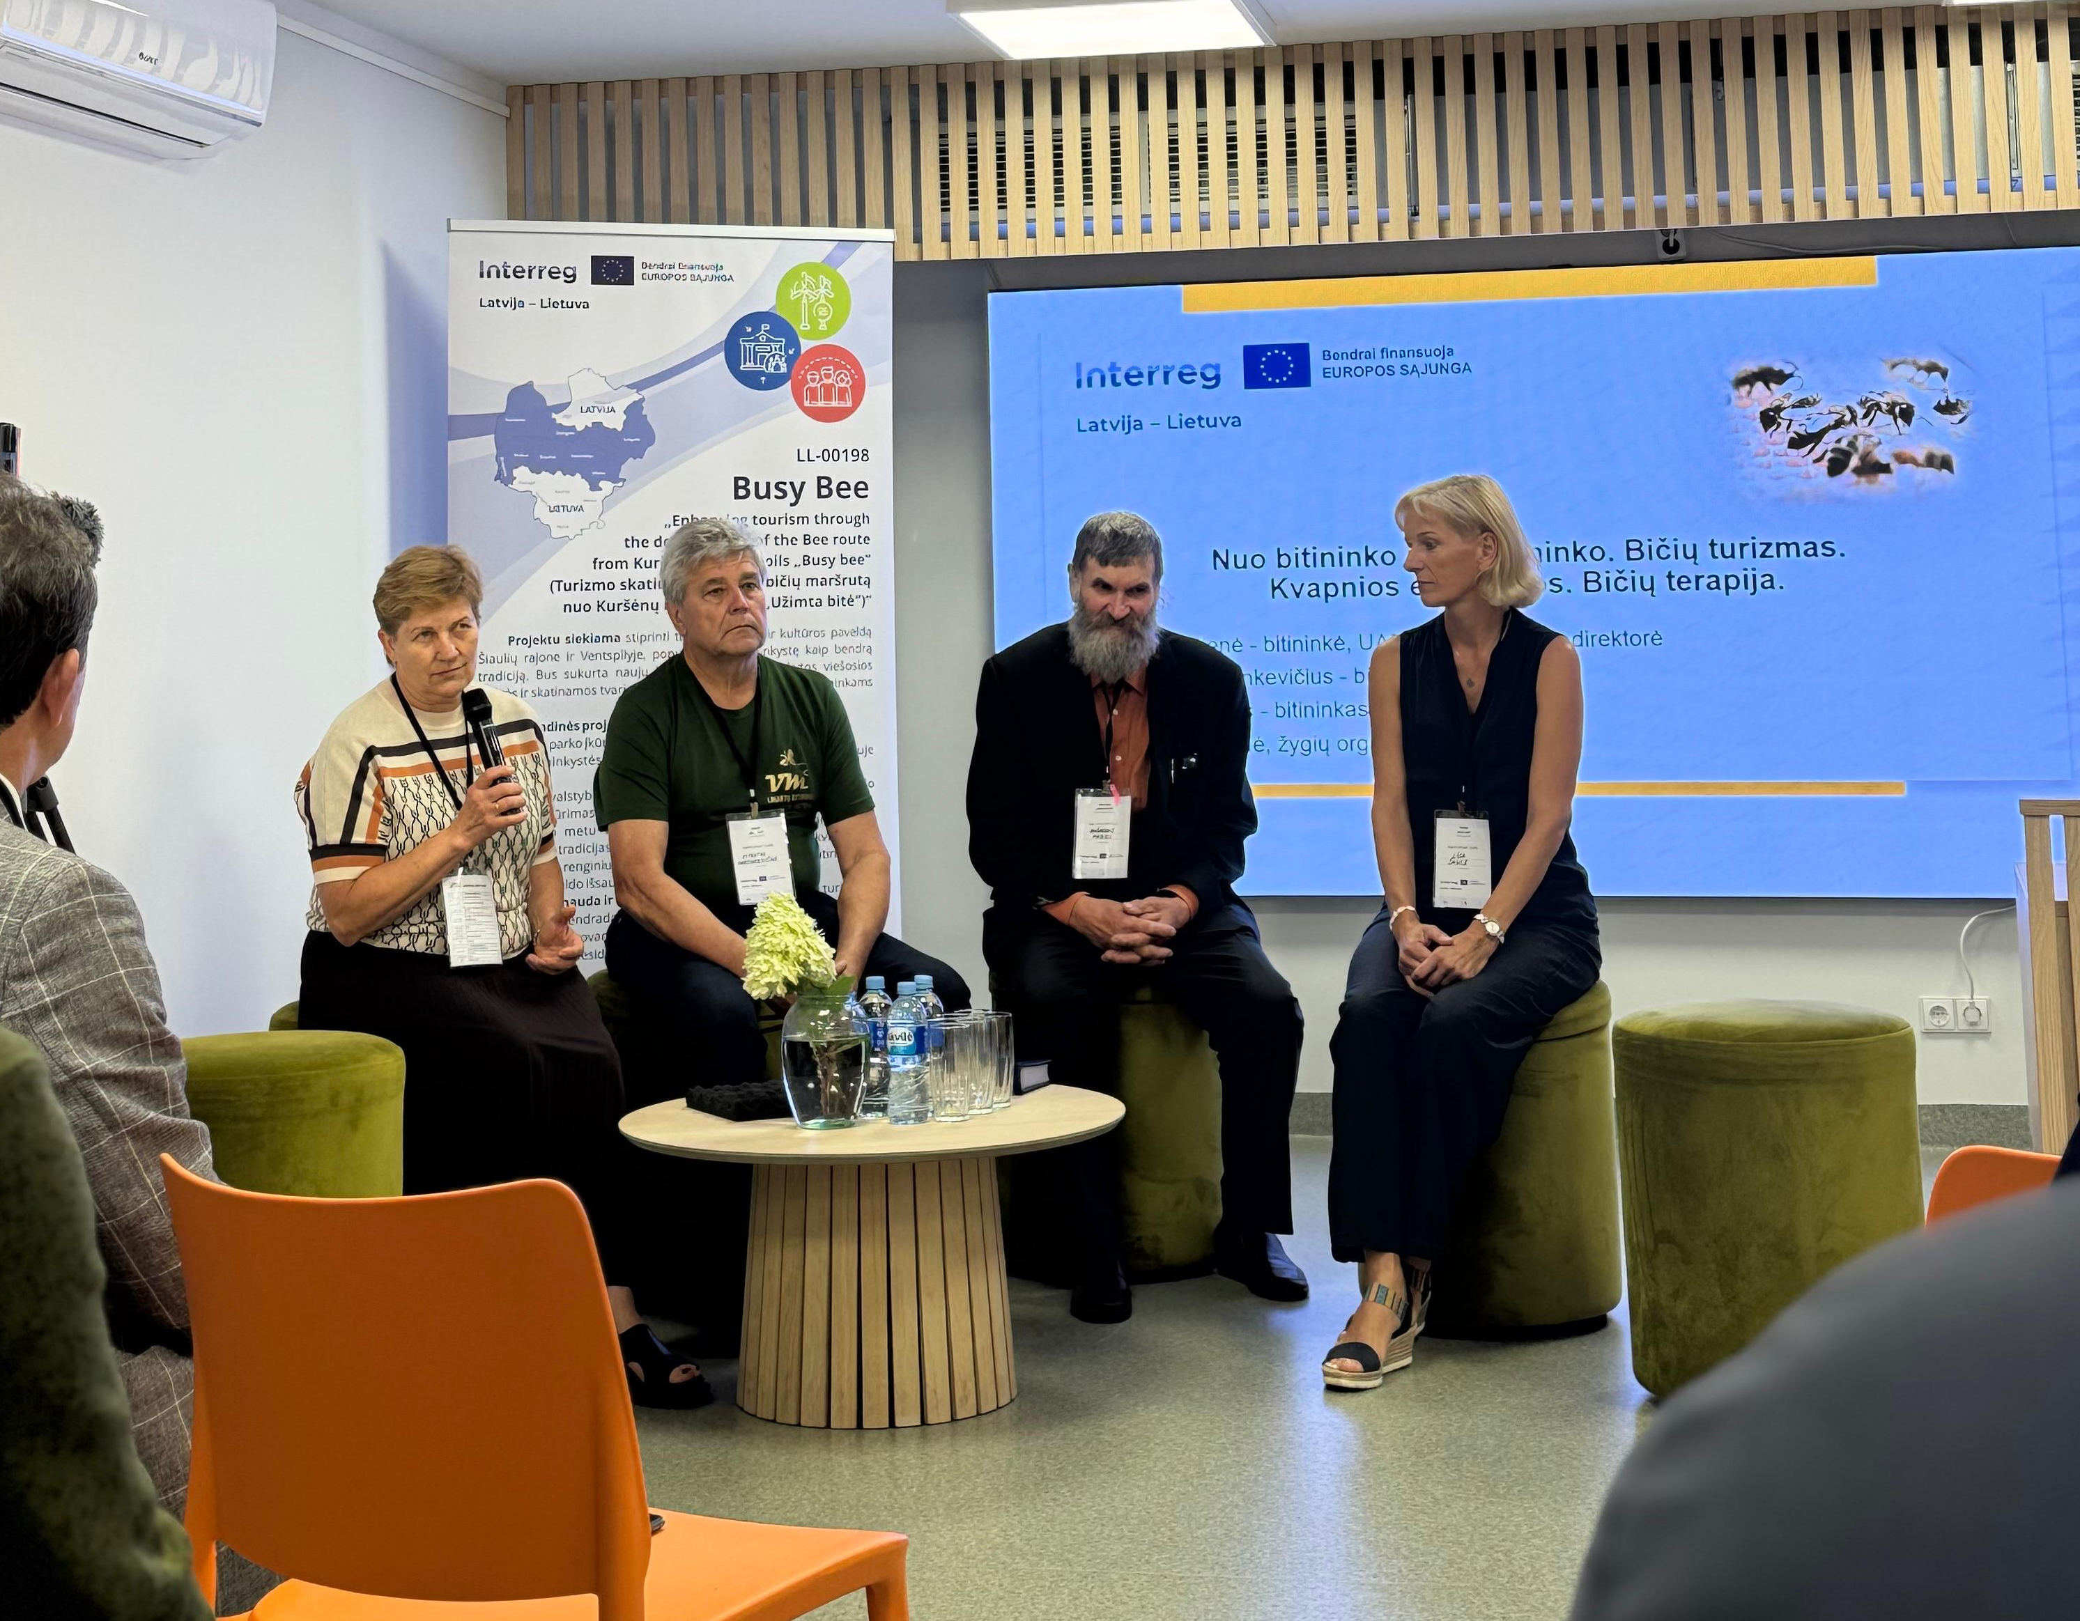
Projects
www.visitventspils.com

Slide 11
Thank You!

